Slide 1

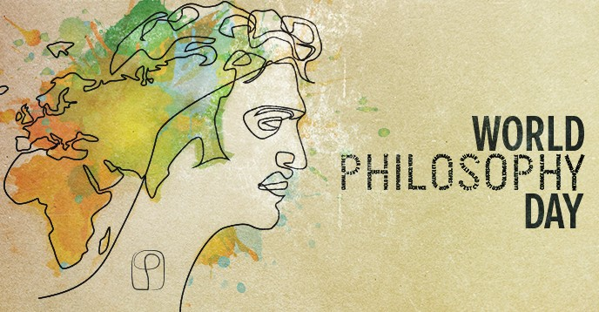


Peace and Stability Dialogue
Co-hosted by:
UQ School of Historical and Philosophical Inquiry
UQ School of Political Science and International Studies
Australian Earth Laws Alliance
Speakers: Mary Graham, Yi Chen, Michelle Maloney, Marcus Foth, Michelle Boulous Walker & Martin Weber
https://hpi.uq.edu.au/article/2019/11/world-philosophy-day-2019-peace-and-stability-dialogue-symposium

Slide 2
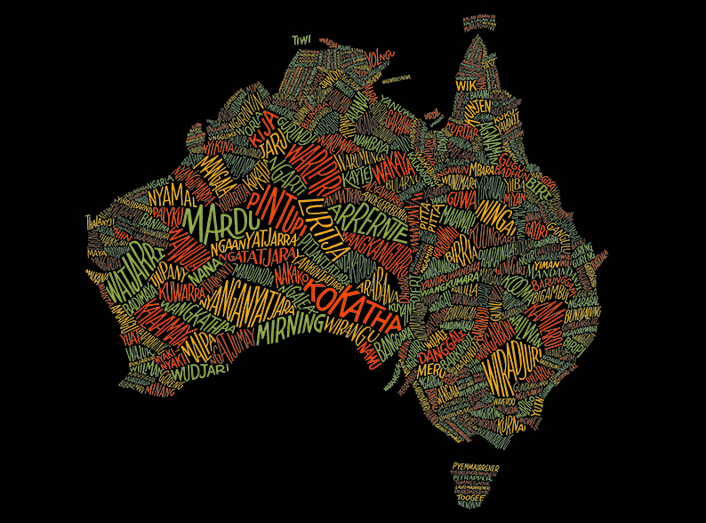

Slide 3
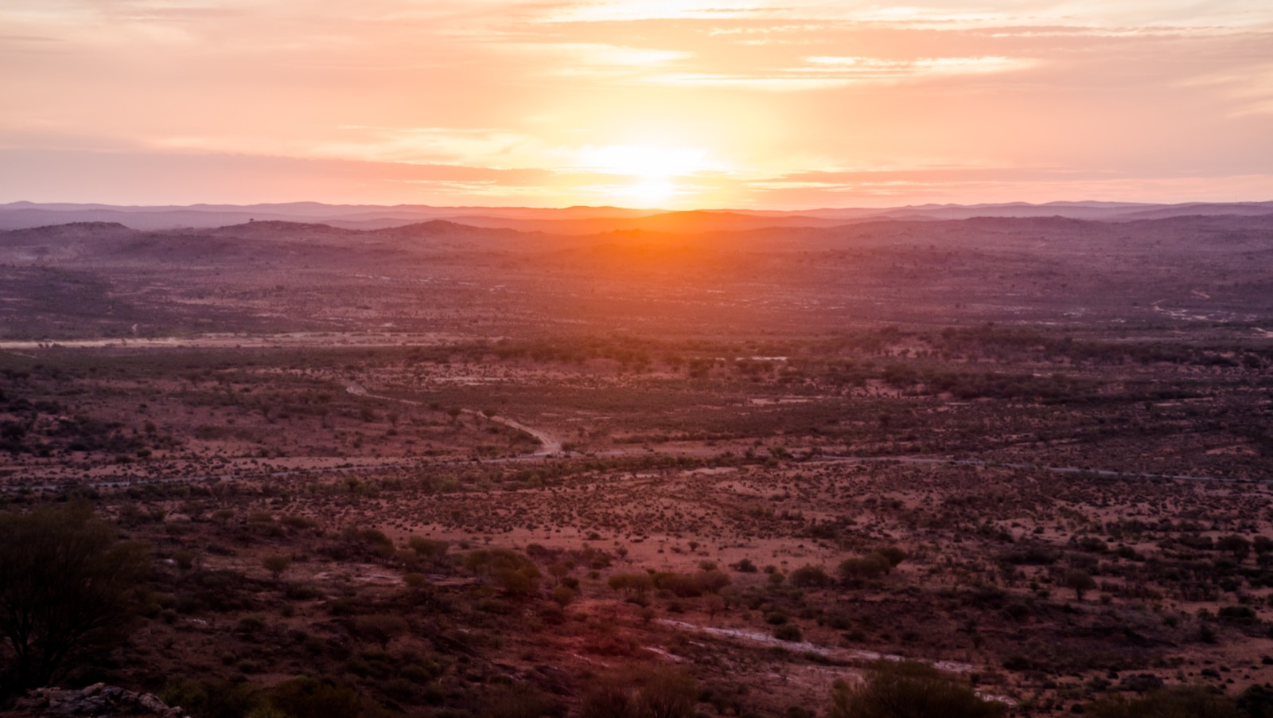
Exploring interdisciplinarity and human relationships with land
MORNING SYMPOSIUM
Opening address and welcome: Gilbert Burgh
Stories (Three Siblings / The Belly of the Snake): Mary Graham
Introductions and Panel Chair: Simone Thornton
Facilitator (Q&A): Morgan Brigg
Speakers: Mary Graham, Yi Chen, Michelle Maloney, Marcus Foth, Michelle Boulous Walker & Martin Weber

Slide 4
The Belly of the Snake
Our old people have been through the fire, the fire of colonialism, that forced a retreat into THE BELLY OF THE SNAKE. Our time spent in the belly of the snake, has been a time of rebuilding our strength and energy, re-gathering and re-arming ourselves with cultural knowledge. Aboriginal people are now emerging from the mouth of the snake and taking over the power of definition, in defining who we are, where we come from, where we belong, and indeed where we are going.
The health of the Land and all its people are dependent on each and every one of us to be responsible for its care, for the care for each other, for the care of our future generations to create a healthier and better society.
The belly of the snake is the very Land we all live on, it is our life force, it is time for us to once more to be in control of running our country based on Aboriginal Terms of Reference. This means the education of White Australians into Aboriginal Terms of Reference, for them to be just as responsible as Aboriginal people to create a healthy country for all of us and our coming generations.
All of us of us who live on this Land have been affected by the event of colonialism, it’s time for white Australians to understand to what extent colonialism has affected them and shake themselves awake and make themselves be part of this emergence from the BELLY OF THE SNAKE.
- Written by Dr Lilla Watson © and used with permission.

Slide 5

PROVOCATIONS
Relationism and Survivalism - Mary Graham
Respect, Autonomy and Place - Yi Chen
Law, Economics and Environment - Michelle Maloney
Media, Technology and Communications - Marcus Foth
Melancholy Politics - Michelle Boulous Walker
Pluralism, Ecology and the Commons - Martin Weber

Slide 6
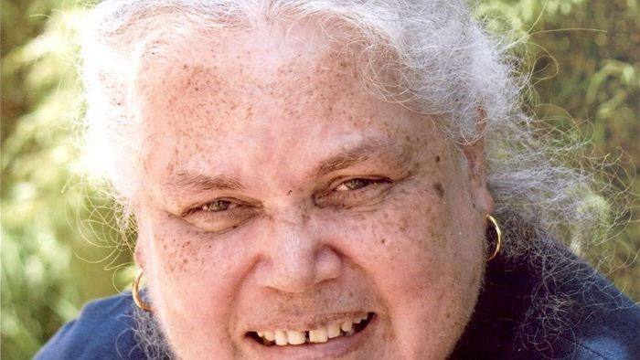

Mary Graham
Relationism and Survivalism
Mary is a Kombumerri person (Gold Coast) through her father’s heritage and affiliated with Wakka Wakka (South Burnett) through her mother’s people.
Mary has worked across several government agencies, community organisations and universities including: Department of Community Services, Aboriginal and Islander Childcare Agency, the University of Queensland and the Foundation for Aboriginal and Islander Research Action. Mary has also worked extensively for the Foundation for Aboriginal and Islander Research Action, as a Native Title Researcher and was also a Regional Counsellor for the former Aboriginal and Torres Strait Islander Commission.
Mary has been a lecturer with The University of Queensland, teaching Aboriginal history, politics and comparative philosophy. She has also lectured nationally on these subjects, and developed and implemented ‘Aboriginal Perspective’s’, ‘Aboriginal Approaches to Knowledge’ and at the post-graduation level ‘Aboriginal Politics’ into university curricula.

Slide 7
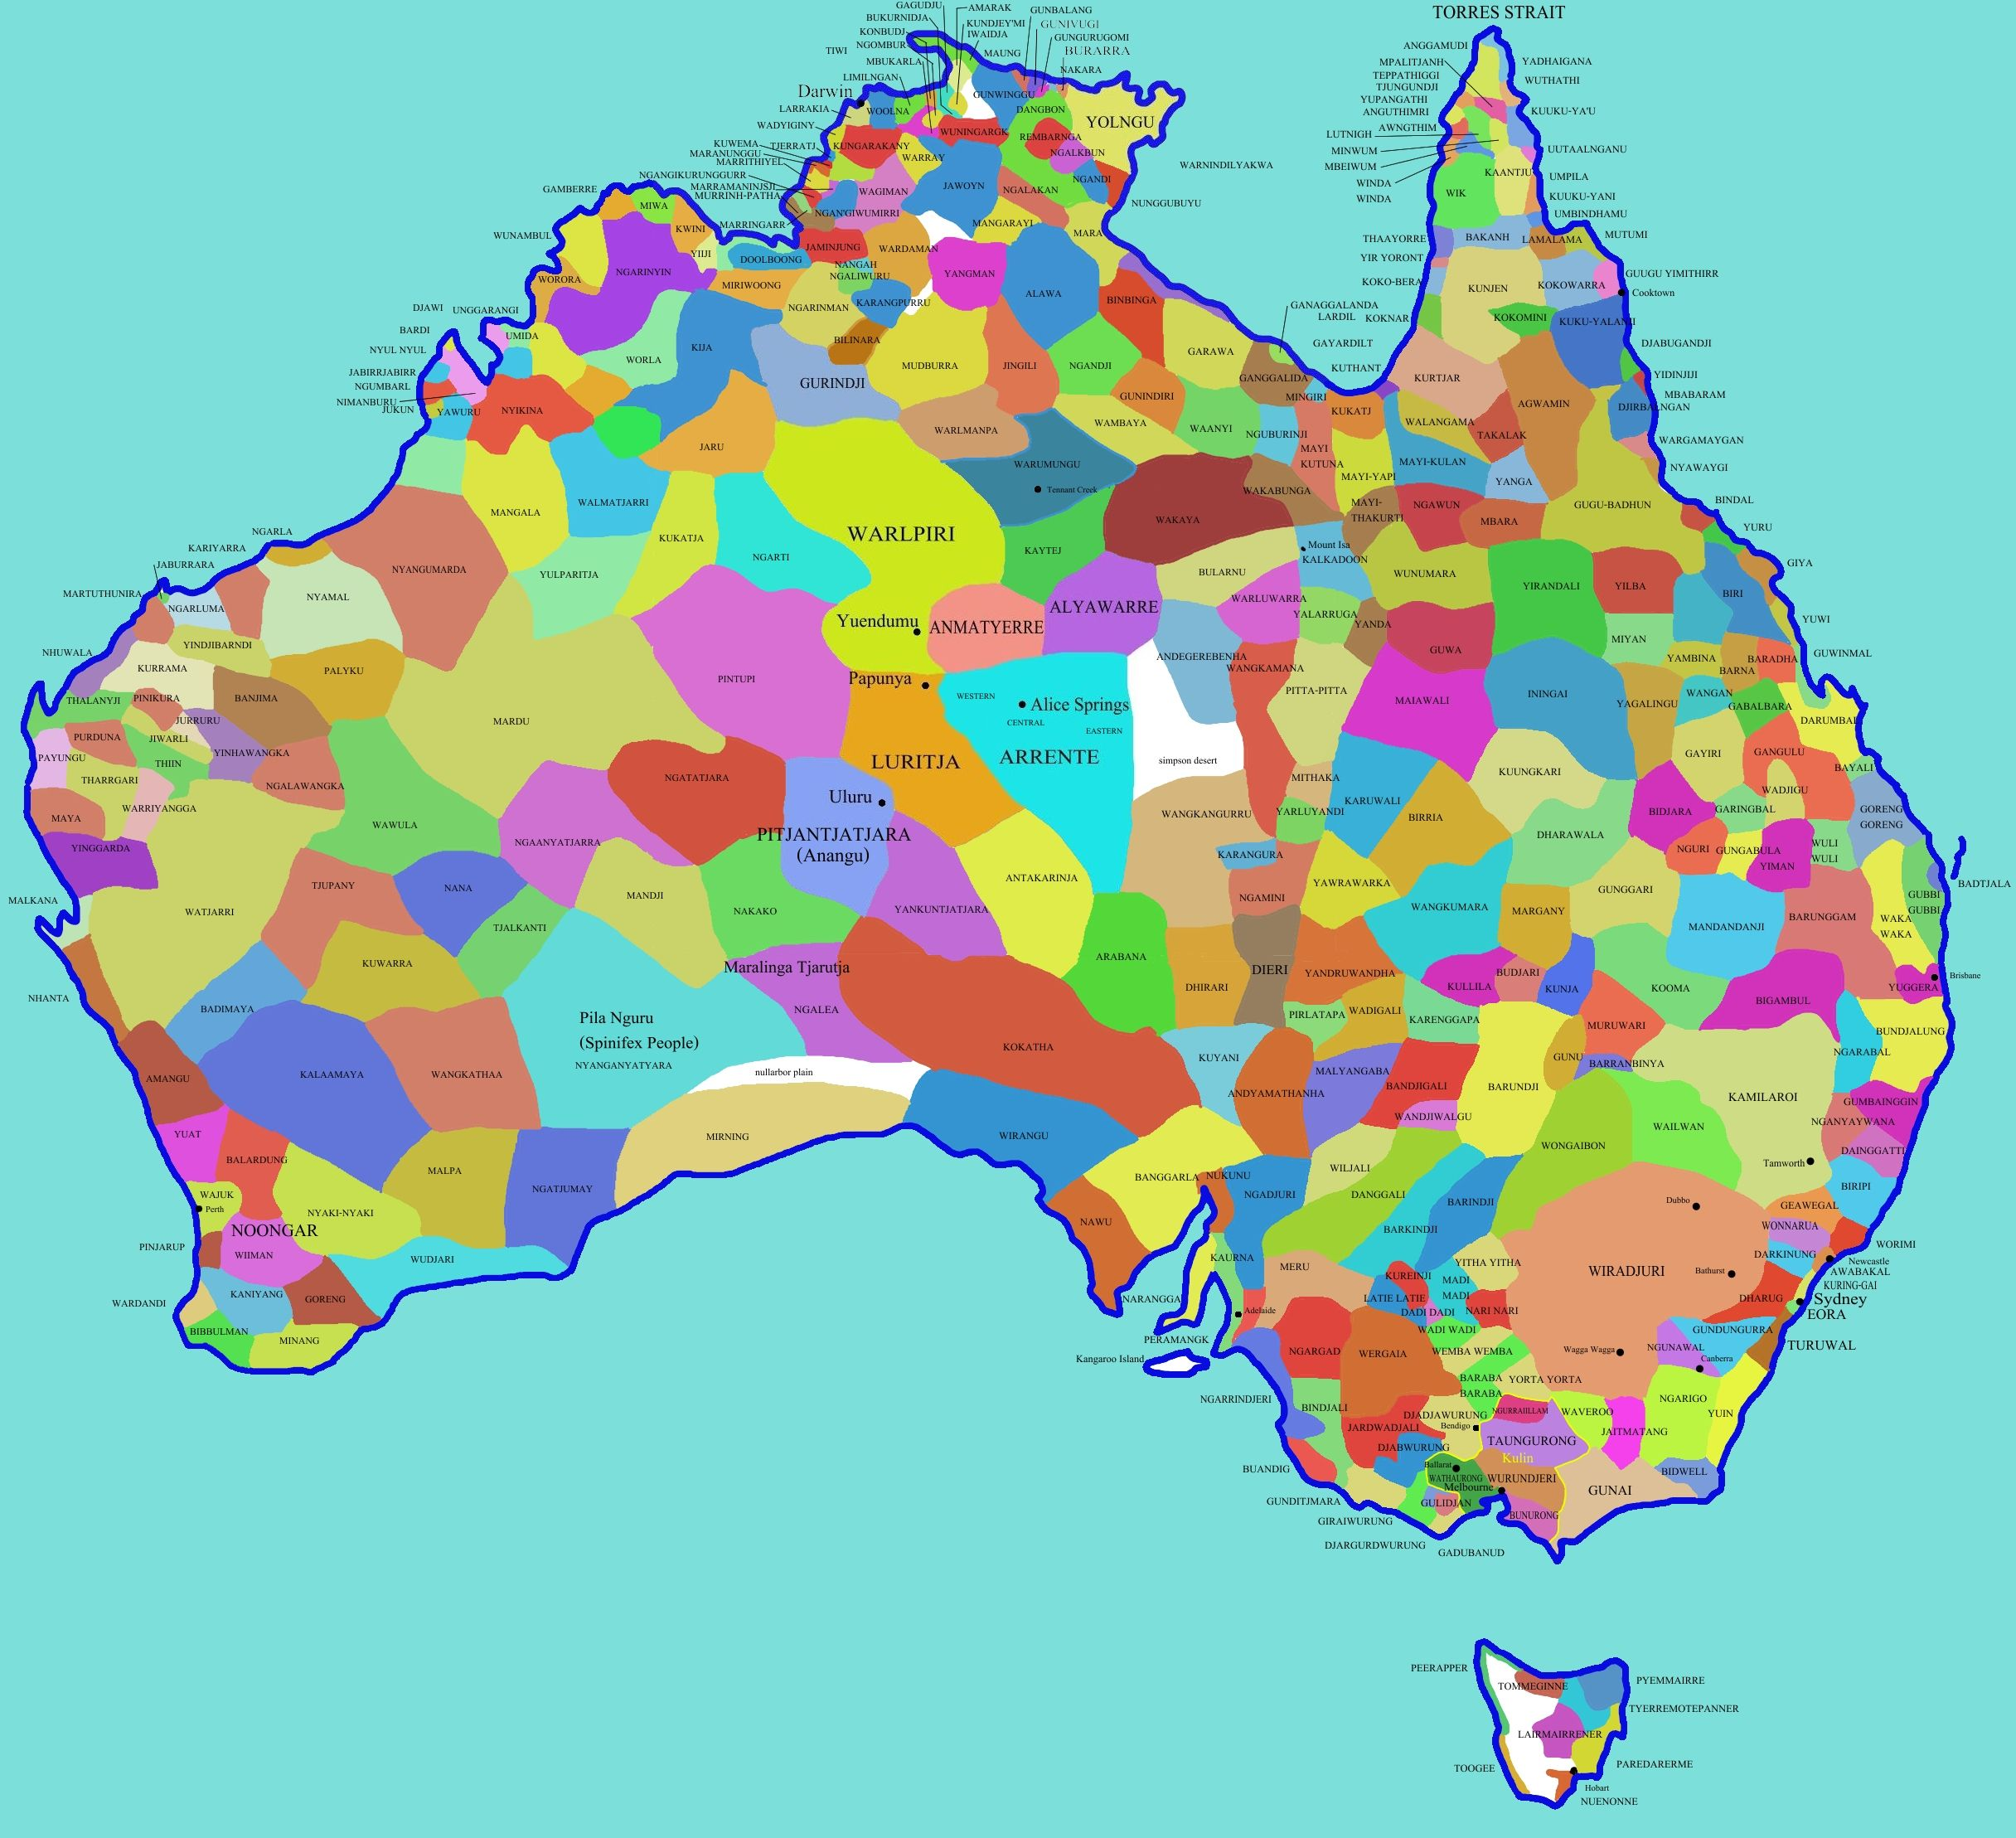

Slide 8
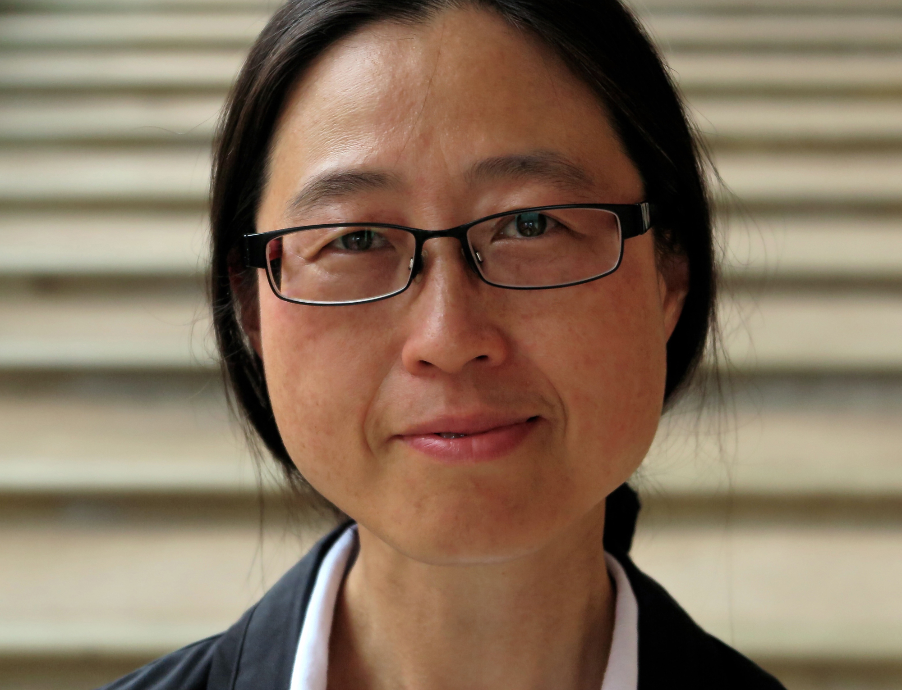

Yi Chen
Respect, Autonomy and Place
Yi Chen 陳怡, currently Assistant Professor of Confucian Philosophy, Bond University, Gold Coast, Australia. Previously Alexander-von-Humboldt Research Fellow at the Max Planck Institute for Empirical Aesthetics in Frankfurt am Main, Germany (2016–2017), working on “Deceptive Simplicity” as an aesthetic principle. Ph.D. in Comparative Literature from the University of Toronto, Canada (2015); M.A. in Classics from the University of Arizona, U.S.A. (2008); Ph.D. in Philosophy from Fu Dan University, Shanghai, China (2001); B.A. in Chinese Literature from Fu Dan University, Shanghai, China (1995). Recent publications include “Respect and Reward: Ecology from the Analects of Confucius” (in Pak Sum Low (ed.) Sustainable Development: Asia-Pacific Perspectives. Cambridge University Press, Cambridge UK, 2019); “Phenomenological Comparison: Pursuing Husserl’s ‘Time Consciousness’ in Poems by Wang Wei, Paul Celan and Santoka Taneda” (Comparative and Continental Philosophy, 2017), and “Who is the Other? Goethe’s encounter with ‘China’ in his concept of Weltliteratur ” (in: Major versus Minor? – Languages and Literatures in a Globalized World, 2015). Current research focuses on defining and leveraging the essence of Confucian Philosophy to address the compelling issues of our time and in this world, including an aesthetically ethical approach to ecology and climate change, and a project to explore the relationship between Confucian Philosophy, Japanese Aesthetics, and Organizational Life.

Slide 9
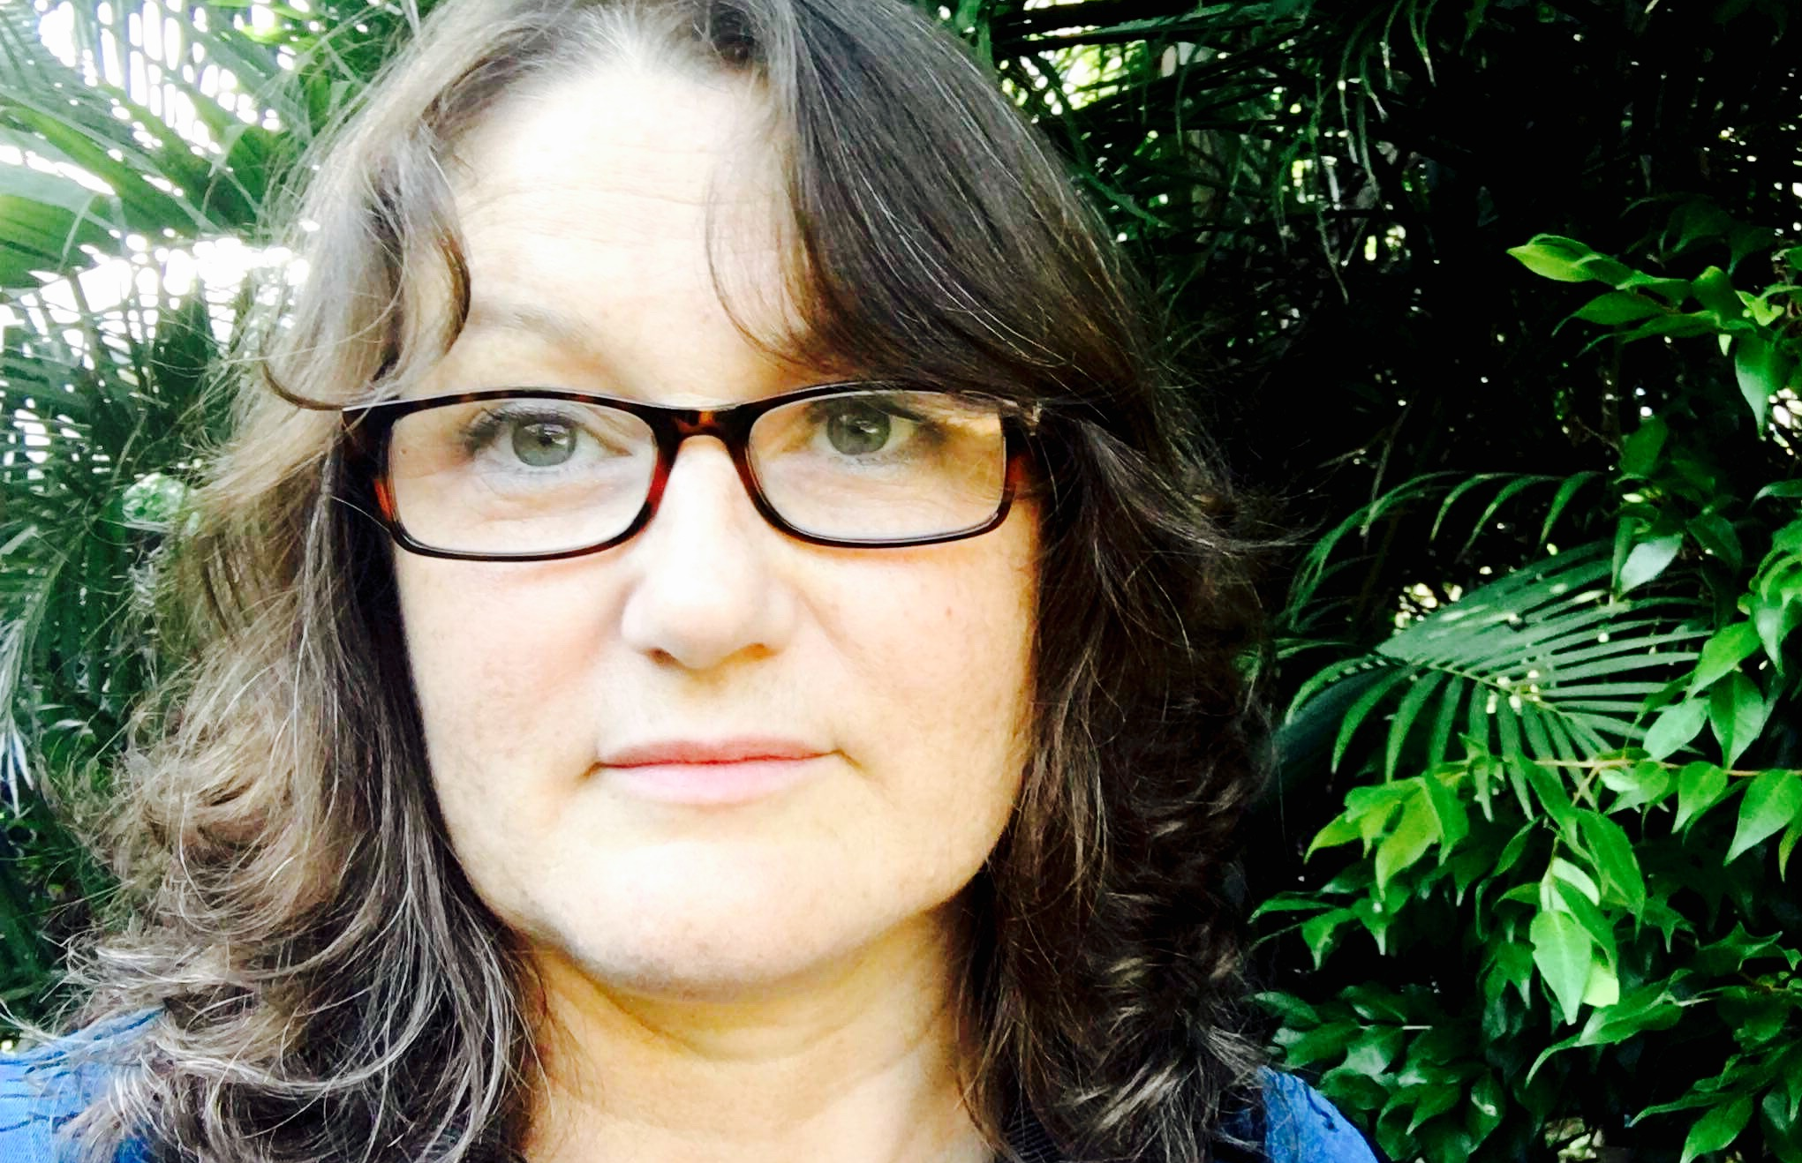

Michelle Maloney
Law, Economics and Environment
Michelle Maloney has a Bachelor of Arts and Law (Hons) from the Australian National University and a PhD in Law from Griffith University, Australia. She is the Co-Founder and Director of the Australian Earth Laws Alliance (AELA); Co-Founder and Director of the New Economy Network Australia (NENA), and Adjunct Senior Fellow at the Law Futures Centre, Griffith University. Michelle’s area of research and program development focus on the practical implementation of Earth centred governance (law, economics, education, ethics), with a special passion for developing governance structures to help us live within healthy ecological limits

Slide 10
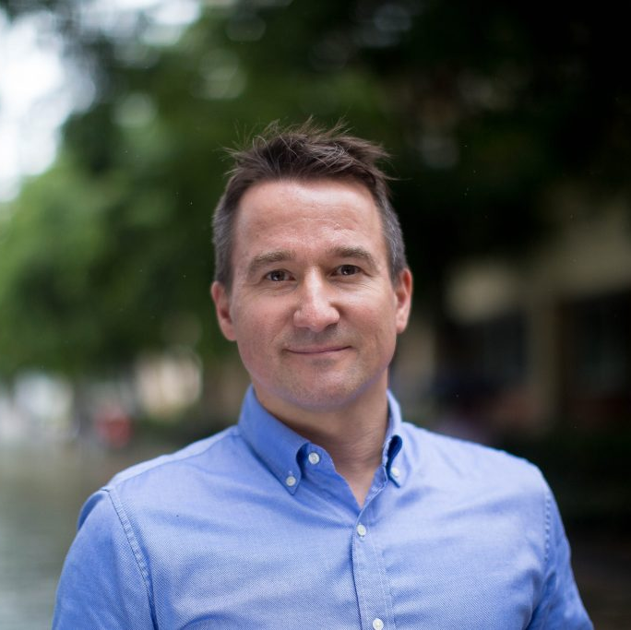
Marcus Foth
Media, Technology and Communications
Marcus Foth is Professor of Urban Informatics in the QUT Design Lab, Creative Industries Faculty at Queensland University of Technology. He is also an Honorary Professor in the School of Communication and Culture at Aarhus University, Denmark, and a Visiting Professor in the Department of Design, Politecnico di Milano, Italy.
Hiss research brings together people, place, and technology. His transdisciplinary work is at the international forefront of human-computer interaction research and development with a focus on smart cities, community engagement, media architecture, internet studies, ubiquitous computing, and sustainability.
He founded the Urban Informatics Research Lab in 2006 and the QUT Design Lab in 2016. Ahead of their time and before the term “smart cities” became popular, he pioneered a new field of study and practice: Urban informatics examines people creating, applying and using information and communication technology and data in cities and urban environments.

Slide 11
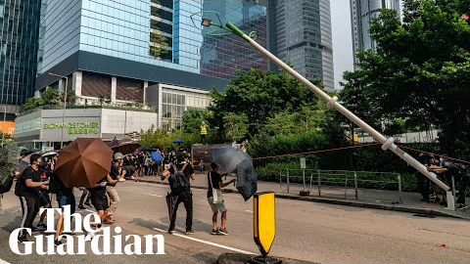

Slide 12

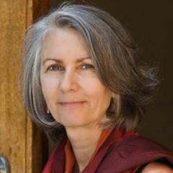
Michelle Boulous Walker
Melancholy Politics
Head of the European Philosophy Research Group (EPRG) and Associate Professor in Philosophy in the School of Historical & Philosophical Inquiry at The University of Queensland. Author of Slow Philosophy: Reading Against the Institution (Bloomsbury 2017) and Philosophy and the Maternal Body: Reading Silence(Routledge 1998); editor of Performing Sexualities (IMA 1994). Other publications span the fields of European philosophy, aesthetics, ethics, and feminist philosophy. Teaching interests in philosophy include intersections with politics, film, and literature. Current research focusses on questions of philosophy and transgressive laughter. mbw@uq.edu.au

Slide 13
    “The life of the mind only attains its truth when discovering itself in absolute desolation.
    The mind … is this power only when looking the negative in the face, dwelling upon it.”
    (Hegel, The Phenomenology of Mind: 93)

Slide 14
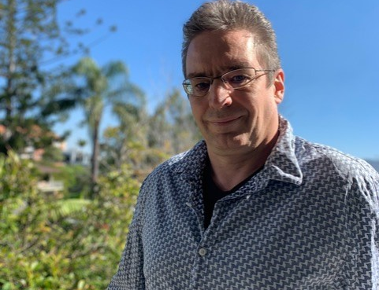

Martin Weber
Pluralism, Ecology and the Commons
Martin Weber is Senior Lecturer in International Relations at the University of Queensland. He has research interests in Environmental Politics, Political Theory, Movement Politics, History of Political Thought (and its limits) and Global Governance.

Slide 15
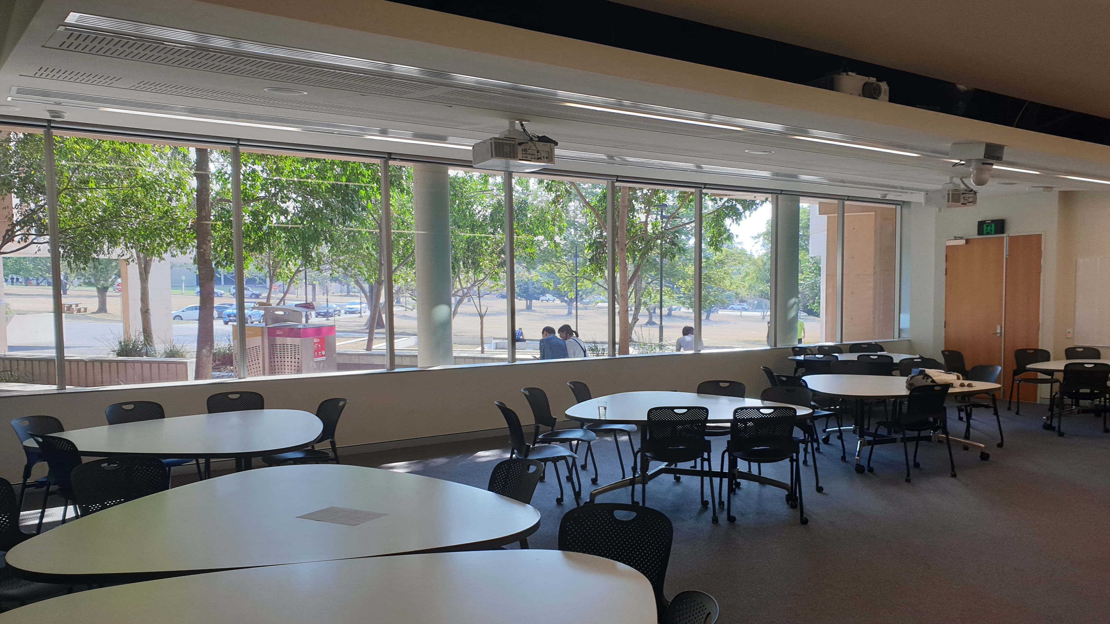
Afternoon session 1:30-5pm in Rm. 217

Slide 16
The afternoon session consists of six small group dialogues, each facilitated by one of speakers on their provocation, with 35 participants focused on establishing an ongoing series of discussions.
Mary Graham - Relationism and survivalism
Yi Chen - Respect, autonomy and place
Michelle Maloney - Law, economics and the environment
Marcus Foth - Media, technology and communications
Michelle Boulous Walker - Melancholy politics
Martin Weber - Pluralism, ecology and the commons
Inter-group facilitator: Morgan Brigg

Slide 17
Acknowledgements
The event aimed to identify, articulate and reflect upon the connection between humans and land, environment, surrounds and context.
Hosted by: The School of Historical and Philosophical Inquiry at the University of Queensland
In collaboration with: The School of Political Science and International Studies at the University of Queensland and the Australian Earth Laws Alliance
Peace and Stability Dialogue Series Organisers:
Mary Graham (School of Political Science and International Studies)
Michelle Maloney (Australian Earth Laws Alliance)
Gilbert Burgh (School of Historical and Philosophical Inquiry)
Morgan Brigg (School of Political Science and International Studies)
Simone Thornton (School of Historical and Philosophical Inquiry)
School of Historical and Philosophical Inquiry event organising team:
Simone Thornton (project coordinator, liaison officer, administration and research)
Gilbert Burgh (coordinator)
Kaitlin Smalley (assistant)
Special thank you to:
Jessica White (administration officer, School of Historical and Philosophical Inquiry)
Donna Moodie (administration officer, School of Historical and Philosophical Inquiry)
Kristen Johnston (communications and publications officer, Faculty of Humanities and Social Sciences)
Funding:
Financial support for research assistance was provided by a School of Historical and Philosophical Inquiry Staff Research Support Fund

